Slide 1


ASTROCAST BY ASTROCODEX
MEMBERS:
Rajveer Jain
Kapil Paliwal
Vinisha Vyas

Slide 2
TABLE OF CONTENTS
01
02
03
04
05
INTRODUCTION
PROBLEM
SOLUTION
TECH STACK
Features overview

Slide 3

ASTROCAST not just weather- intelligent, NASA-backed climate insight
AI-powered weather and climate insight web app that helps users plan events smarter by combining:
Real-time forecasts from OpenWeatherMap
Historical & climate data from NASA POWER API
AI-driven analysis for quick, human-like answers
Our Vision:
To make weather forecasts actionable, trustworthy, and climate-aware, enabling users to plan events confidently while staying informed about long-term climate change.

Slide 4
MAIN PROBLEM
Uncertain Weather Planning
Lack of Context & Climate Awareness
Data Overload, No Intelligence
Planning outdoor events is risky — even with modern weather apps. Users can’t easily know if their event day will be safe from rain or heat, leading to last-minute chaos or cancellations.
Most weather apps show forecasts, not meaning. They ignore historical climate trends, so users never see how conditions have changed over decades — especially as climate change alters rainfall and temperature patterns.
Forecast data is available everywhere — but it’s not actionable. Users get numbers (°C, mm, %), not decisions or recommendations. No integration of AI + NASA climate data to explain what it means in plain language.

Slide 5
KEY SOLUTIONS
NASA-POWERED HISTORICAL INSIGHTS
Event-Centric Weather Forecasting
We designed a system where users enter a city and event date, and instantly get forecast. No more scrolling through data — direct answers like “Yes, it might rain 🌧” or “Clear skies ☀.”
Integrated NASA POWER API to fetch 30+ years of historical climate data.
🌡️ This gives users meaningful context — “How does this month compare to past averages?” — adding climate intelligence beyond normal forecasts.
AI-DRIVEN DECISION SUPPORT
CLIMATE-AWARE SCORING SYSTEM
Built an AI layer that interprets weather + climate data to provide natural language insights and recommendations.
🤖 Example: “Rain probability is 70%, historically this month is dry — an unusual pattern linked to climate shifts.”
Introduced a Parade Suitability Score (0–100) by combining forecast + NASA data.
🏆 Gives a single, easy-to-understand rating so users can decide quickly — great for event organizers, schools, and local planners.

Slide 6
Technology Stack & Data Sources
1. Core Framework
2. Weather & Climate APIs
3. AI & Natural Language Assistant
🧩 Streamlit (Python) — foundation of the app for building a fast, interactive, and intuitive web interface. ⚡ Enables smooth integration of APIs and dynamic visualization.
🌤️ OpenWeatherMap API — real-time and 7-day weather forecasts (temperature, humidity, rain probability). 🛰️ NASA POWER API — 30+ years of monthly averages for temperature & rainfall, providing long-term climate context.
🤖 OpenAI / Gemini API — powers the AI Assistant for conversational weather queries. 🗣️ Converts raw weather data into human-friendly answers and climate insights.
Mapping & Visualization
6. UI/UX & Frontend Design
5. Data Processing
We added an interactive map that shows the selected city and its weather details. The app also displays simple charts for temperature, rainfall, and trends — making the data easy to see and understand instead of just reading numbers.
⚙️ Python
handle data cleaning, calculations, and transformations. 🧮 Powers custom models like the Parade Suitability Score and Climate Change Insight Analysis.
Streamlit Components + Custom CSS for clean, modern visuals. 🌈 Intuitive layout with buttons like “Compare Cities”, “Climate Trends”, and “AI Assistant Mode.”

Slide 7
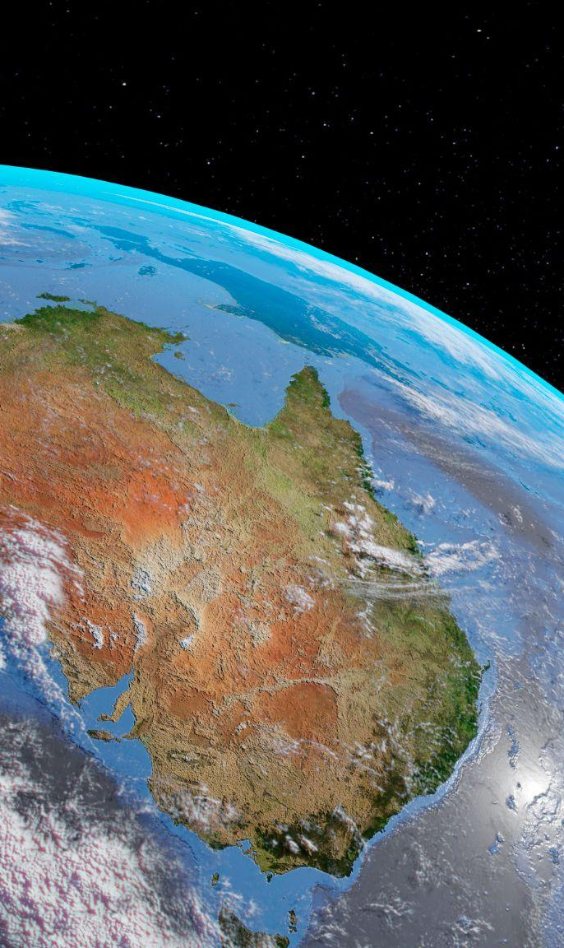
Features Overview
Quick Weather Forecast
Parade Suitability Score (0–100)
Detailed Weather Insights
Climate Change Insights
NASA Historical Climate Data
AI Assistant Mode

